Slide 1
SDN/OpenFlow
Presented By
Elie Daou
Grant Moyer

Slide 2
What is SDN?
Software-Defined Networking
Software-Defined Networking, or SDN, is the idea that the physical routers in a network are separated from processes like routing, which happen in a central location.
Notes:
Can give definition, then say we will review what we have now, and how SDN is better in some case.
Buzz phrase: “Networks are programmed not configured”

Slide 3
The Way Things Are
“The Old”

Slide 4
The Old
Does these Things well
Decentralized
No single point of failure
Limited Intelligence at the Core of the network
Scalability
All proprietary hardware/software
Reliable Customer Support
Notes:
Like here, I was thinking about talking more about the Bellman-Ford equations, and how they are useful in routing when a link “cost” goes down, but it’s difficult when one goes up, still easy to implement across the entire internet
Since limited intelligence at the core, you can scale it to the entire internet without a problem
Proprietary information:
cysco, juniper, and avia control the market,
a lot of closed software that they support

Slide 5
The Old
Does these Things poorly
Routing problems
Count to infinity
Relatively complex algorithms
Network topology
Expensive router hardware
Hard to update routers
All proprietary hardware/software
Hard to change platforms
Notes:
Routing Problems
The algorithms are complex because they have to deal with asynchronous execution and no router has global information.
Network Topology
large overhead for routers to have global topology information; need lots of memory in each router
Expensive router hardware
Router hardware is expensive because each router needs to be able to run routing algorithms.
Hard to update routers
It’s hard to update forwarding tables because routing needed to be initiated in each individual router.
Proprietary
Have to stick to a platform, or change the entire system

Slide 6
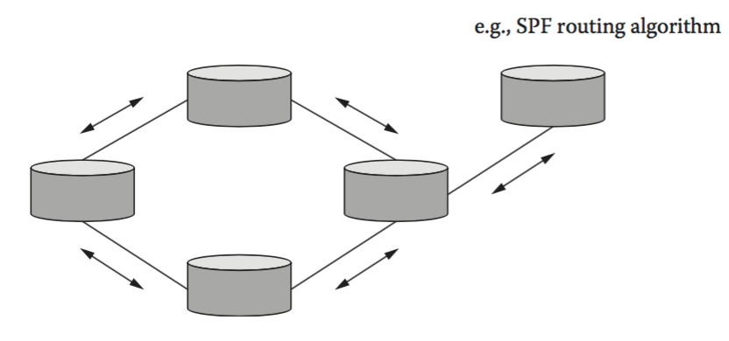
The Old
What’s the flow
Notes:
Talk about the various routing algorithms a current router might use

Slide 7
The Way Things Could Be
“The New”

Slide 8
The New
What’s Does it fix?
Routing
Relatively simple algorithms
Global Topology Information
Inexpensive router hardware
More dynamic changes
Notes:
Routing
simple algorithms because of global information
Network Topology
Controller can have global state information with no overhead for routers. still needs lots of memory, but only in controller
Inexpensive router hardware
routers only need to handle forwarding, not routing
More dynamic changes
changes are all handled by central server

Slide 9
The New
Problems
Single point of failure
Communication/ Universal protocol
Scalability
Can not run the Internet on it
Limited to intranets
Notes:
Single point of failure
if a single controller fails, potentially all forwarding tables become non-updatable
universal protocol
Define OpenFlow, talk about why there needs to be a protocol
scalability
very good and easy to implement on any scale intranet, impossible for entire Internet

Slide 10
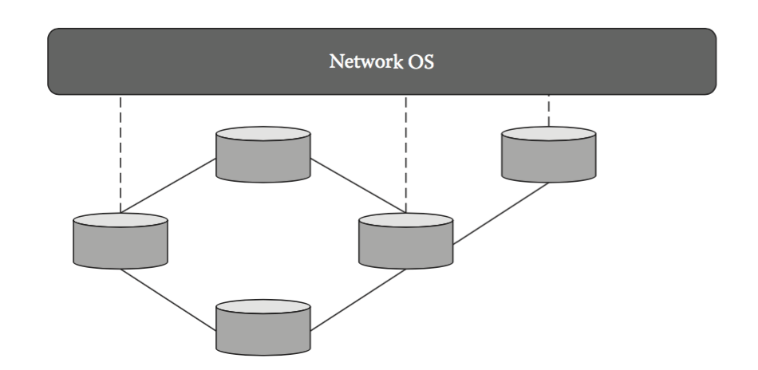
The New
Flow
Notes:
This Picture is to show the general idea of SDN, the specific flow of OpenFlow and OpenDaylight will be after the OpenFlow slides

Slide 11
OpenFLow

Slide 12
What is OpenFlow?
OpenFlow is a protocol that allows central SDN server to communicate with individual routers
Notes:
Grant:
OpenFlow is a protocol used by routers/switches and controllers for implementing SDNs. For example, OpenDaylight is SDN controller that uses OpenFlow to communicate with routers.
Open Source! OpenDaylight and OpenFlow are open/ crowd-source (community driven)

Slide 13
OpenFlow
Allows SDN controller to manipulate routers
Runs on top of TCP
Uses port 6653
Routers maintain a flow table
Forwarding tables populated by the Controller only
3 types of message
Controller-to-switch message
Asynchronous message
Symmetric Message
Notes:
Grant:
controller to switch messages are most important
flow table entries have:
Match Fields - matches packet headers
Priority - if this match should be considered over others
Counters - incremented for every matched packet
Instructions - what to do with the matched packet, i.e. modify or forward
Timeouts - how long flow lasts without being used
Cookie - chosen by controller and used for things like filtering statistics. not used by router
3 types of message
controller-to-switch message
used for controllers to actually control switches and routers, populate flow tables, configure queues, etc.
asynchronous message
used by switches/routers to signal controller for errors, and if the controller asked it to (flow removed, specific action).
Symmetric messages
used by both controllers and routers/switches for echo requests and replies
also has “Experimenter” type which is made to be used for user defined behavior

Slide 14
Controller-to-Switch messages
Handshake
sent when TCP connection is established
prompts switch to send information to controller
Modify Flow Entry Message
Flow table entries can be added, modified, or deleted
Notes:
Grant:
this list is inexhaustive; it only contains the major types of message
Handshakes

Slide 15
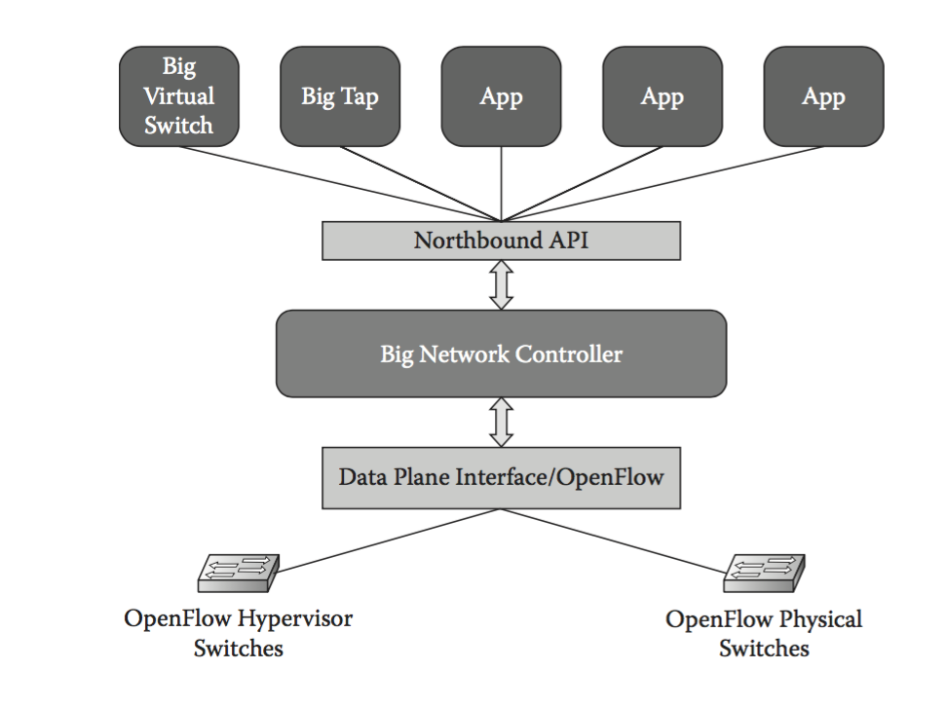
The New
Flow
Notes:
Hypervisor switch = virtual switch Physical switch = actual switch Need OpenFlow “enabled” switches to talk with an OpenDaylight Controller

Slide 16
Questions?

